Slide 1
Business Intelligence
DON’T GET KICKED

Slide 2

The Problem
Auto dealerships purchase many of their used cars through auto auctions with the intent to buy it in the best possible condition
Risk-Buying a faulty car which cannot be sold
Bad buys are termed as kicks
Losses can be minimized if the dealers can predict whether a car is kicked or not

Slide 3

Objective
Our goal is to mine the dealerships’ data i.e., data of cars purchased at an auction
Consequently provide the dealership with a model that will help them predict if the car purchased was a good buy or a bad buy (kick)

Slide 4
Data Description
Data Source- Kaggle.com (https://www.kaggle.com/c/DontGetKicked)
No of rows-72983
No of attributes-34
No of input variables-33
Year of data analyzed-2009-2010
Target Variable- IsBadBuy

Slide 5
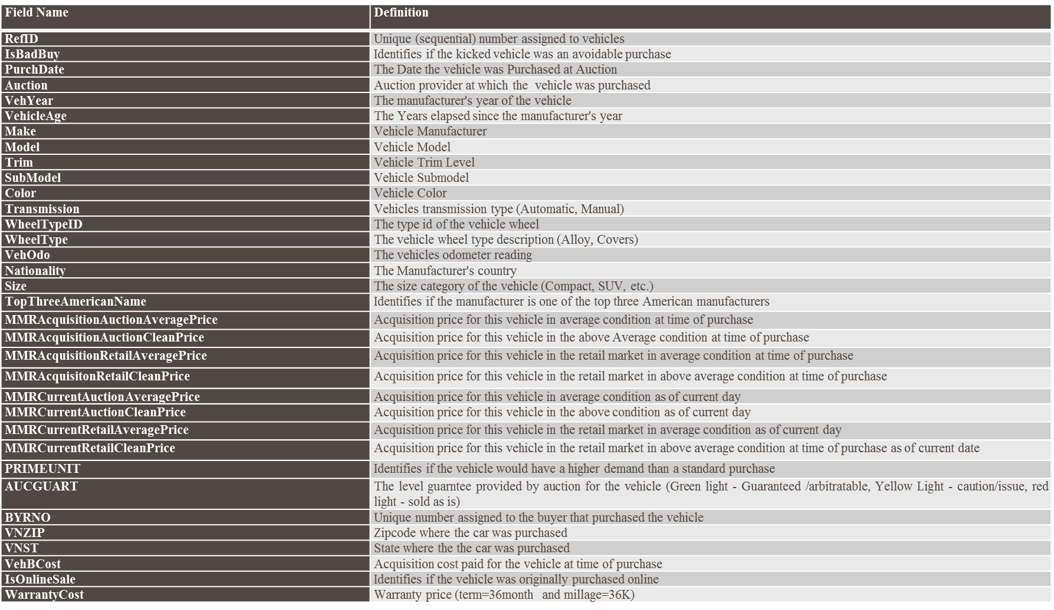
List of Variables

Slide 6
Redundant Data
Data was imported using File Import node and a few variables were observed to be redundant in nature
“VehYear” and “VehicleAge” - “VehYear”
“VNZIP” and “VNST” - “VNZIP”
“WheelType” and “WheelTypeId” - ‘WheelTypeId’

Slide 7
Insignificant variables
Following variables do not help us in our prediction model
RefId – It contains the serial number of vehicles
PurchDate - The Date the vehicle was purchased at Auction. It has dates from 2009 to 2010. Also, more than 50% of the records do not have value

Slide 8
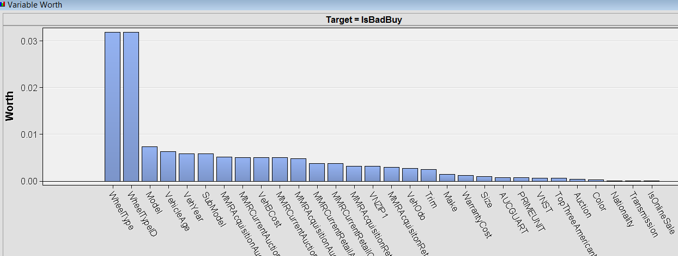
Stat Explore
It gives us a summary of the number of classes for each of the nominal variables, a count of the missing values for each attribute
It also shows the importance of each variable once it is imported in SAS.
Variable worth using Stat Explore

Slide 9
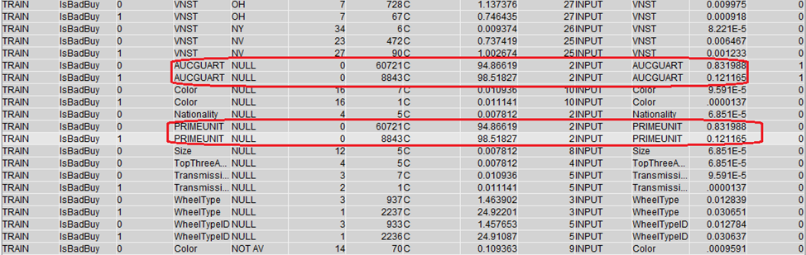
Data Preprocessing
We can reject the following variables:
AUCGUART - The level guarantee provided by auction for the vehicle (95% null values & low variable worth by statexplore)
PRIMEUNIT - Identifies if the vehicle would have a higher demand than a standard purchase (95% & low variable worth by statexplore)

Slide 10
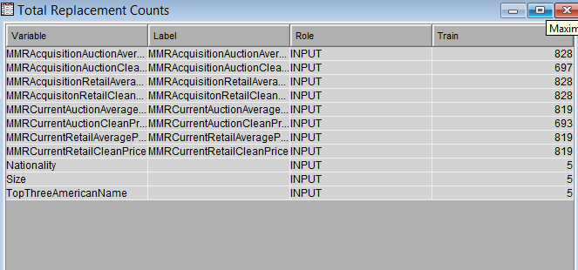
Data Replacement
We can replace all missing values with ‘.’
Variables storing price of the vehicle have some values as ‘0’ , so we consider them as missing
Taking 1 as the lower threshold limit for all the price variables and replacing them, as well, with ‘.’

Slide 11
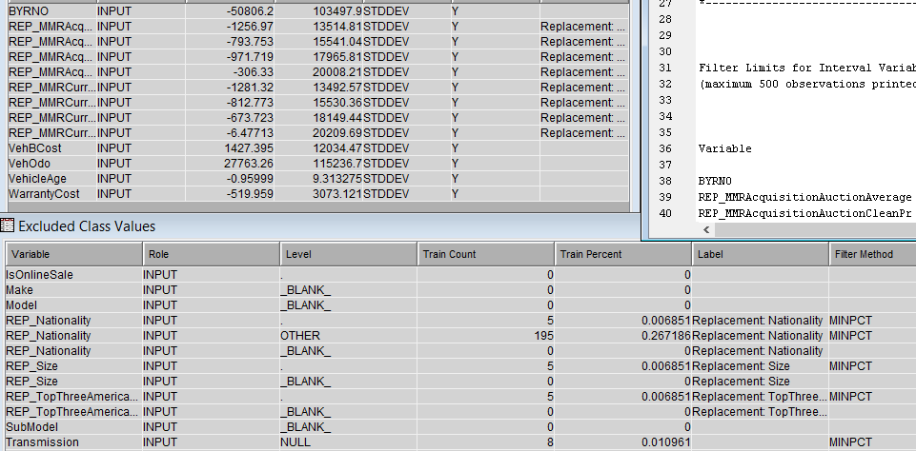
Filter
Excludes outliers or other observations that are not significant
Default filtering method ‘NONE’

Slide 12
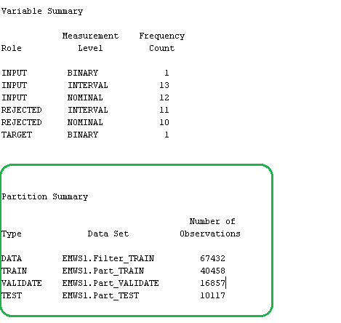
Data Partition
Training Data
Data
Validation Data
Testing Data

Slide 13
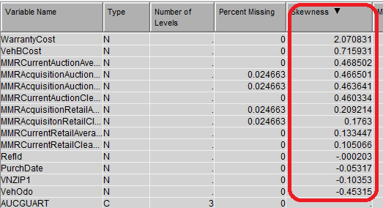
More Data Processing
Interactive Binning
We used this to bin the variables which had a high class level count.
Attributes ‘Model’, ‘Sub Model’, ‘Trim’, ‘Color’ and ‘Transmission’ were chosen.
Model and SubModel had initial class levels count of more than 500 which later reduced to 51 and 40 respectively.
Impute
This node was used to replace the missing values.
Missing values of interval data was replaced with the mean
Missing values for Nominal/Binary data was replaced with the most frequently occurring value
Transform Variables
Helped us reduce the skewness of variables.
Logarithmic transformation was applied on the attribute ‘WarrantyCost’.
We tried to create a few more formulae such as creating binary variables for VehicleAge and WheelType.
But that ultimately resulted in an increase in the Misclassification Rate. Hence we deleted the newly created variables.

Slide 14
Data Mining Techniques Used
Decision Tree
Neural Networks
Gradient Boosting
Logistics Regression

Slide 15
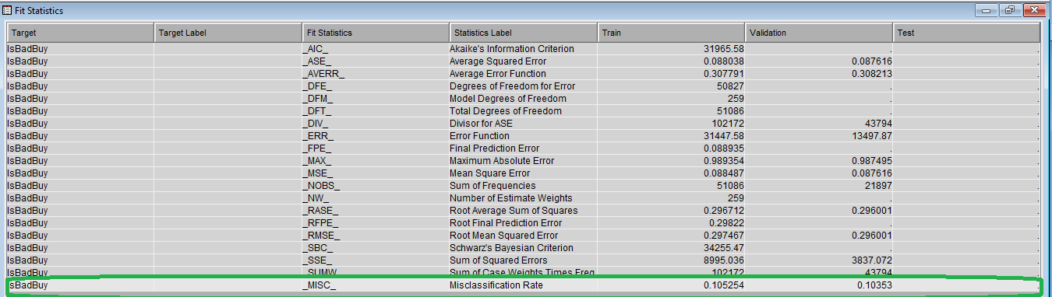
Decision Tree
Result: Misclassification rate is 10.35% which is comparatively higher than the regression models. Hence we do not use this model for our analysis.

Slide 16
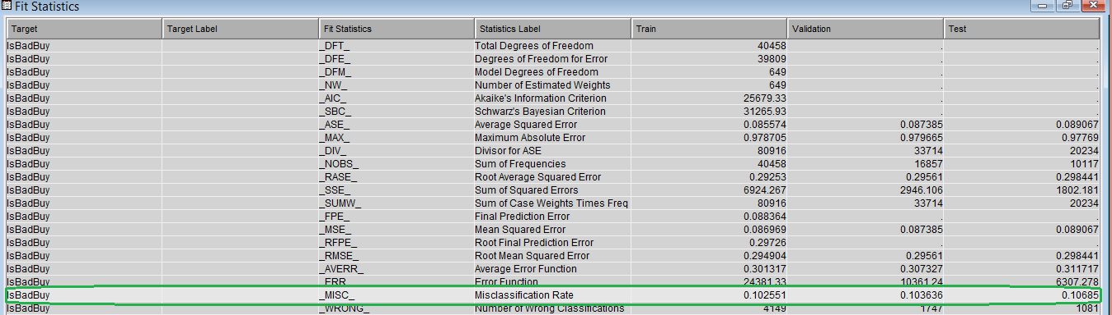
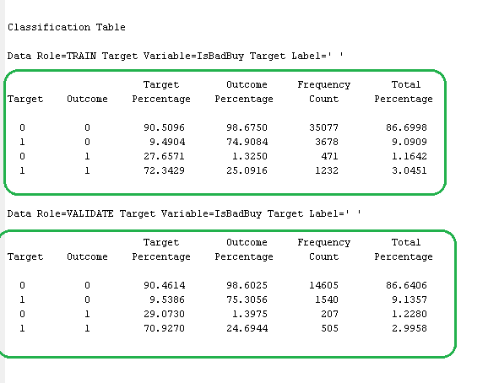
Neural Networks
Result: Misclassification rate is 10.3638%
The 10.3638% misclassification rate consist of 9.14% false positive, and 1.23% false negative.
This means 9.14% of the predicted bad buys in the modal are in fact good buys; 1.23% of the predicted good buys predicted in the modal are bad buys.

Slide 17
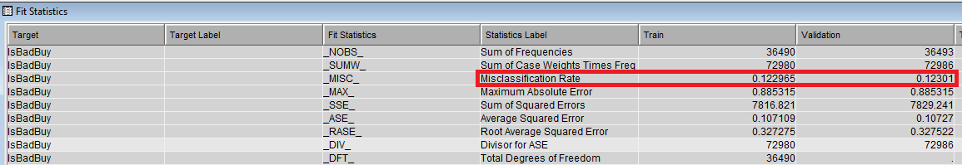
Gradient Boosting
This Model creates ‘the series of Decision Trees’ by fitting the residual of the prediction from the earlier tree in the series.
Result: Validation Misclassification Rate = 12.3%

Slide 18
Logistic Regression
Selection Models Used:
None
Forward Regression
Backward Regression
Stepwise Regression

Slide 19
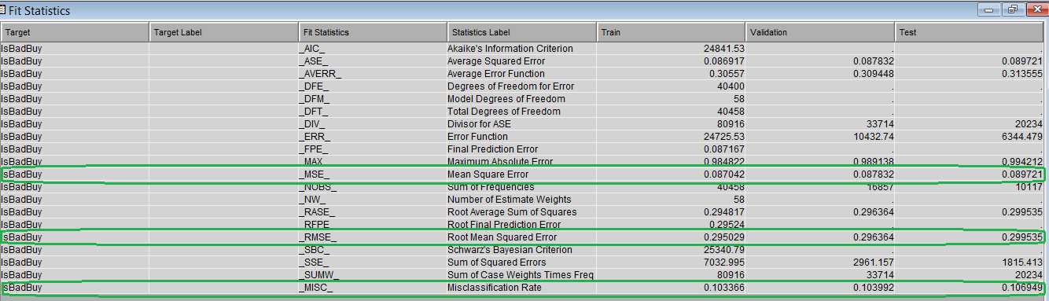
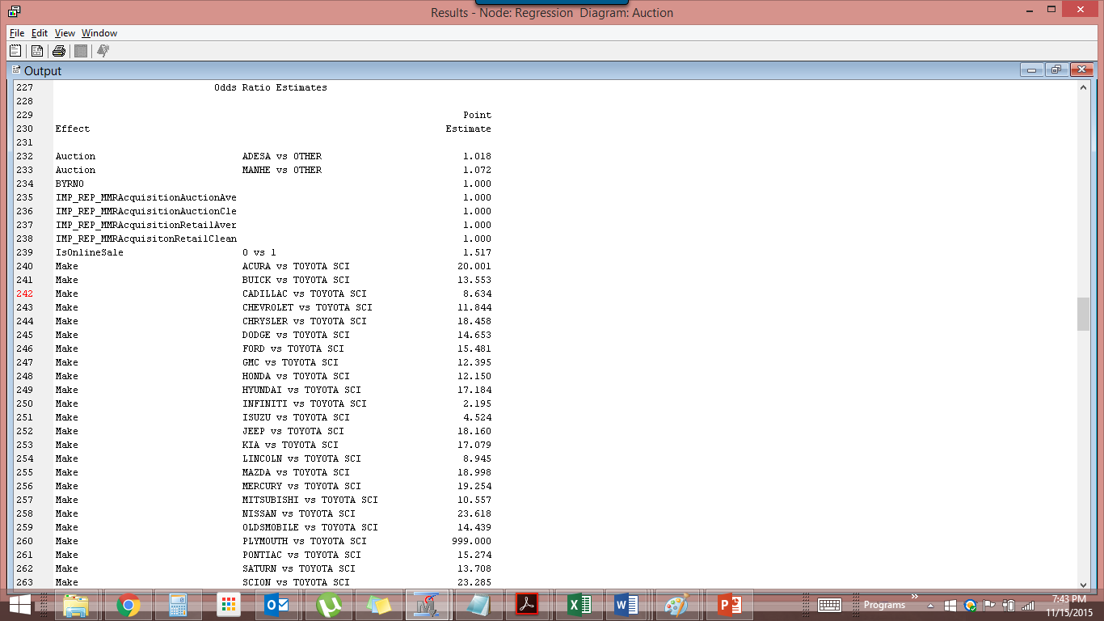
Logistic Regression (None)
Initially we tried it directly after interactive binning from which we got the misclassification rate as 10.3399%
Then we performed logistic regression after transforming variables, for skewness. Here the misclassification rate did not change
The results talk about the importance of the variables in the regression model

Slide 20
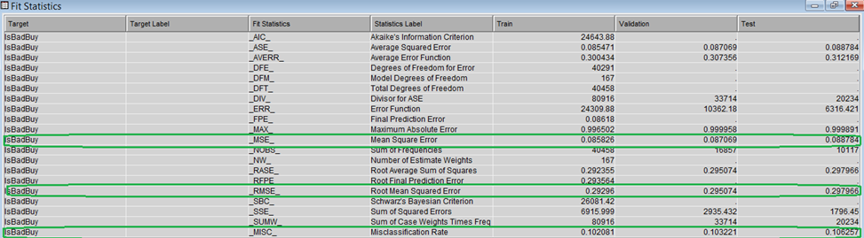
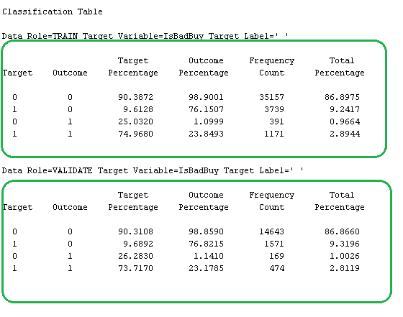
Logistics Regression (Forward)
Result: Misclassification Rate is 10.322% for the validation dataset, which seems to be a good result
The above classification table
9.32% false positive 1% false negative.
This means 9.32% of the predicted good buys are in reality bad buys, and 1% of the predicted bad buys are in reality good buys.

Slide 21
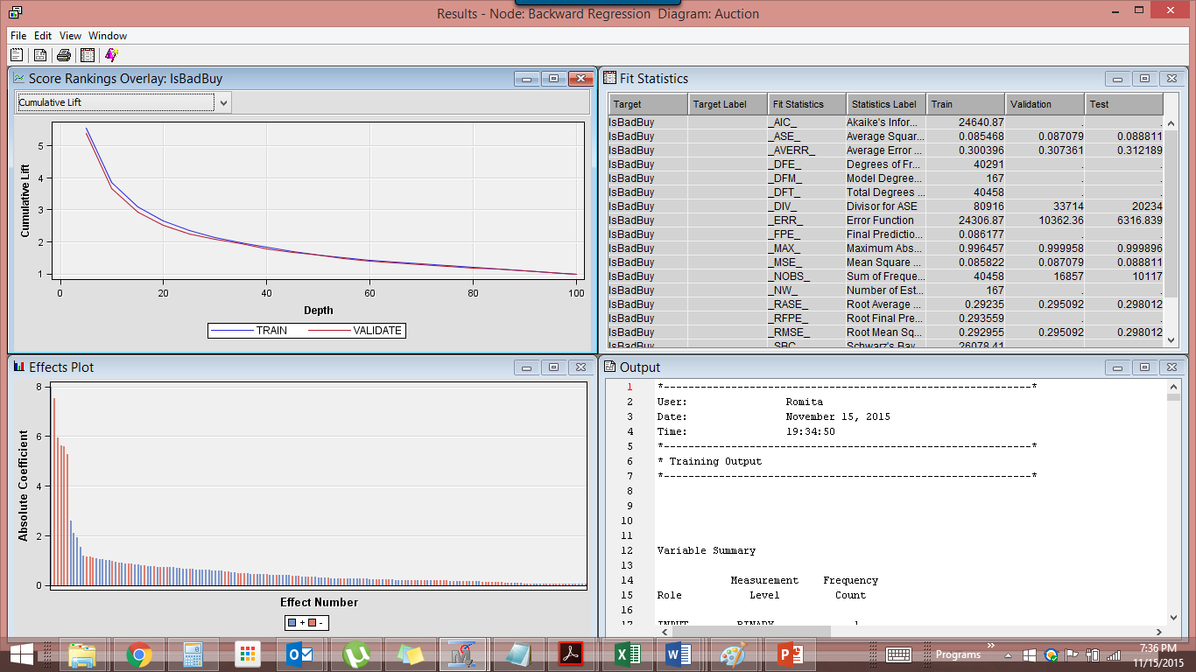
Logistics Regression (Backward)
Backward regression starts with all available transformed input variable
It drops the variable that has the least impact on the model fit in each step.
24 variables were used
10-nominal variables
13-interval variable
1-binary variable

Slide 22
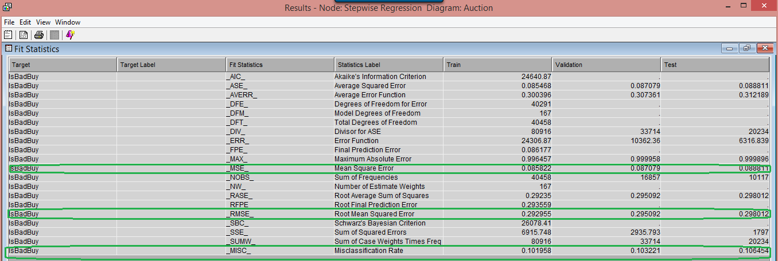
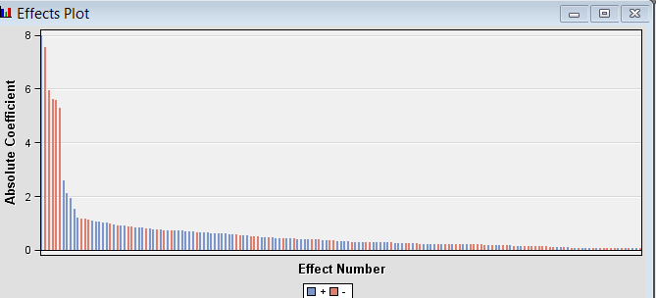
Logistics Regression (Stepwise)
The misclassification rate comes out to be 10.3221 %
Stepwise regression shows that the analysis starts with the attribute ‘WheelType’

Slide 23
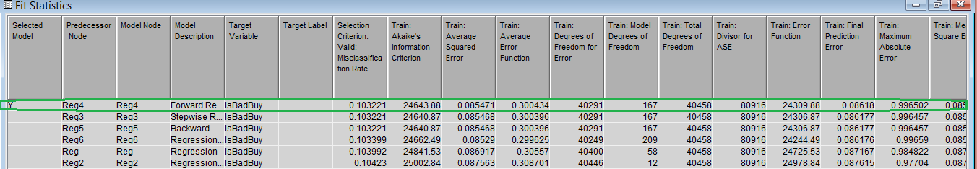
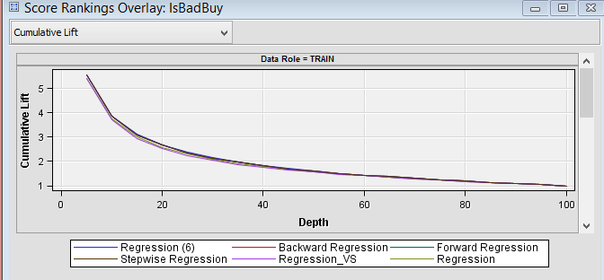
Model Comparison
SAS selects forward logistic regression as the best model with a misclassification rate of 10.3221%
The cumulative lift chart for all the regression models

Slide 24
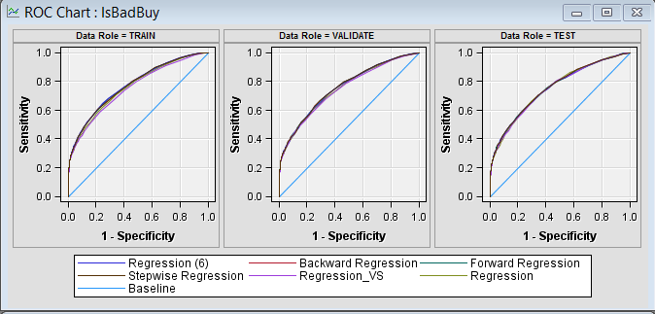
ROC Chart
ROC chart for our models with Forward Regression as the closest one which shows the best accuracy.

Slide 25
Conclusion
Forward Logistic regression was the best model chosen for the prediction of kicked cars.
Reason :least misclassification rate and a good r-square value.
This model also showed slight higher accuracy than the other models we tried.

